Slide 1
The art and limitations of accurate forecasting
By Nataliya Portman
Manager of Data Science
360insights.com
SORA seminar, Toronto
September 18, 2019

Slide 2
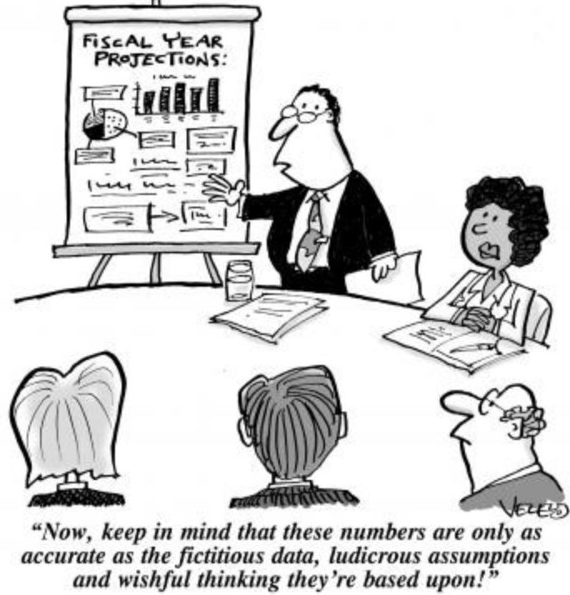
Outline
Why accuracy of forecasting matters
Driving factors of efficient and accurate forecasting
Short- and long-term forecasting of target KPI metrics
Estimation of sales lift due to promotional programs
Prediction of reward winners based on purchasing behaviour analysis
Conclusions
KPI – Key Performance Indicator

Slide 3
Why accuracy of forecasting matters
Effective investment (e.g., incentive) or inventory management
Alignment with go-to-market strategy
Business goal setting
Strategic planning to increase sales growth
Realistic expectations on sales team performance
Sales volume forecast by
Product type
Service/rebate program type
Dealer
Time period
Notes:
To many businesses, sales forecasting is a necessity. The insightful foresight that a good sales forecast provides is the source of information that allows to manage vital aspects of business.
The sales forecast allows you to get a good estimate of the demand for the products you sell. The more accurate the forecast, the better prepared your company will be to manage its inventory, avoiding over-stock and under-stock situation. The business can save the money on excess inventory.
In regards to investment management such as incentive expenses, for example, a periodically (updated monthly or quarterly) forecast allows the planned budget to be adjusted in the course of time as market conditions change.
Go-to-market strategy serves as a guide for the execution of a product map that involves creation of demand conditions, demand management, evolution of a product and penetration into new markets. Strategic planning of a product life cycle goes hand in hand with forecasting. Forecasting estimates the results given the plan. Incentive programs for business customers or product consumers such as volume rebates or consumer rebates are a part of go-to-market strategy.
At 360insights, we focus on incentive program design and management and forecast what will happen in the future if a particular incentive strategy is implemented. Forecasting can be thought of as a tool for evaluation of these strategies as it monitors its execution. Will the company achieve its profitability objective? Will the company increase its market share in the next year? These are important business questions that have to be periodically addressed in order to take a timely action on changes to the incentive plan or business objectives.
Revenue forecasts of sales team members can provide insights into short-term and long-term performance of the company’s sales teams. Do sales reps meet their quarterly sales goals? Accurate revenue projections will inform sales reps whether they will reach their quota and will spot risks of losing money in a timely manner.
To achieve a higher prediction accuracy, we segment data by product type and build product specific predictive models since their sales usually follow different trends and seasonal patterns. It also makes sense to build separate predictive models for different rebate program types since they are structured differently and they are designed to meet different sales goals. For forecasting purposes, we create time series of sales volumes aggregated by week, month or quarter.

Slide 4
Driving factors of efficient and accurate forecasting
Open-source and commercial technology
Data preparation
Experimentation
Model registration and management
Deployment
Package the model
Model prototyping
Advanced Analytics database
Data querying
Deploy service
Feature engineering
Training, hyperparameter tuning
Accuracy assessment (hold out method)
Preprocessing
Retrain and update models
Notes:
Technology is one of the driving factors of efficient forecasting that motivates experimentation with predictive model building and accurate model discovery. There are many frameworks and statistical and machine learning libraries that have been developed in R or Python and new ones that are always evolving. These software tools are essentially high-level libraries that allow quick model prototyping.
We take advantage of AWS cost-effective relational database services that provide with database setup and maintenance, scalability, fast query performance and secure access to data.
When it comes to DS pipeline automation, we use a revolutionary technology called Docker that allows to package all the software required to run your Python application into a container. The container is then deployed to the cloud server or Amazon lambda for efficient code execution. We rip the benefits of Amazon lambda services for running serverless code. All you need to do is to define an event that will trigger Python to execute the code. Since AWS lambda supports cron expressions, we can create our Lambda function and schedule it to run periodically. Basically, every month or quarter a new event will be created that will invoke our Lambda function (it consists of a code that processes events, a runtime and our source code and dependencies packaged to a Docker container).
We do benefit from utilizing these technologies as they allow full automation of the forecasting pipeline that results in automatically generated up-to-date forecasting reports every month of the year.

Slide 5
Driving factors of efficient and accurate forecasting
Methodology as a result of experimentation that yields the most accurate KPI estimates
Experimentation
Application 1: Next quarter sales volume forecast
Build optimized seasonal ARIMA models of product sales volumes by rebate program
weekly
Compute average value of model predictions per rebate program
monthly
Model prototyping
quarterly
Application 2: Rest of year incentive spend forecast at dealer level
Feature engineering
Existing dealers: Build optimized monthly seasonal ARIMA models of % contribution to overall incentive expense
New dealers: Build monthly moving average models
Build optimized seasonal ARIMA models of total revenue
Training, hyperparameter tuning
Accuracy assessment (hold out method)
Per dealer, compute 1. % accuracy,
2. Rest of year forecasted $ sales volume

Slide 6
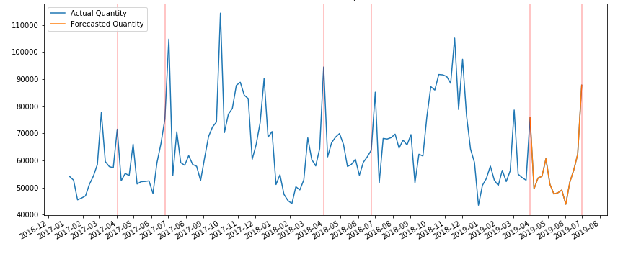
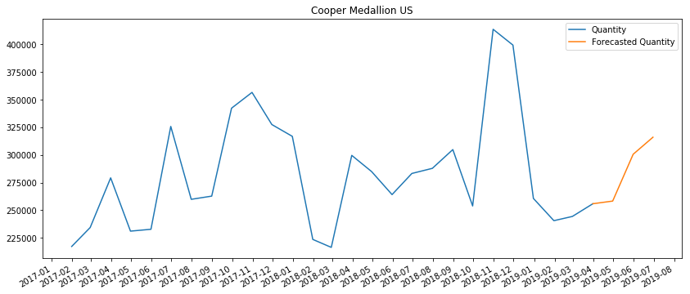
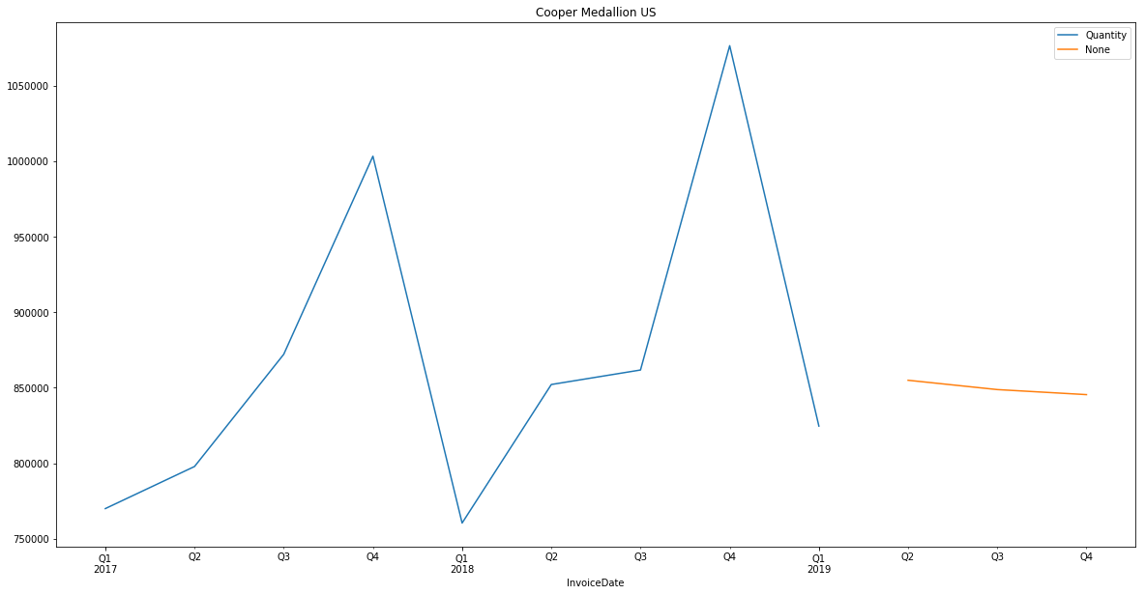
Long- and short-term forecasting of target metrics
Weekly sales
SARIMA (Seasonal Autoregressive Integrated Moving Average)-based sales volume models at different time scales capture multiple trends over time.
Weekly sales model is particularly useful for short-term forecasting.
It forecasts higher than usual sales volumes in the
last week of the quarter.
Actual
Unit volume
Forecasted
Monthly sales
Quarterly Sales
Q2 2017
Q2 2018
Q2 2019
Unit volume
Actual
Forecasted
Forecasted
Actual

Slide 7
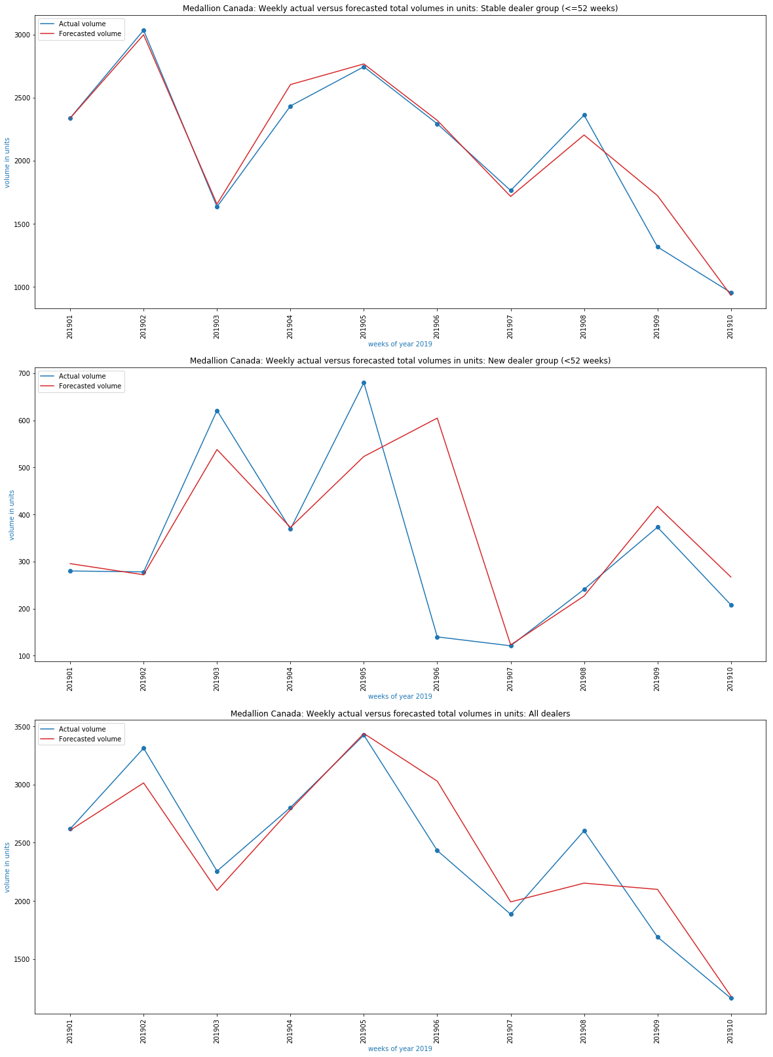
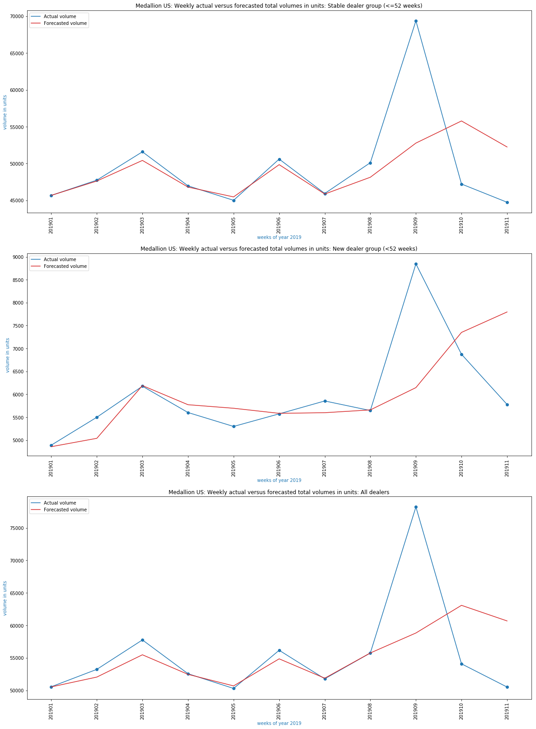
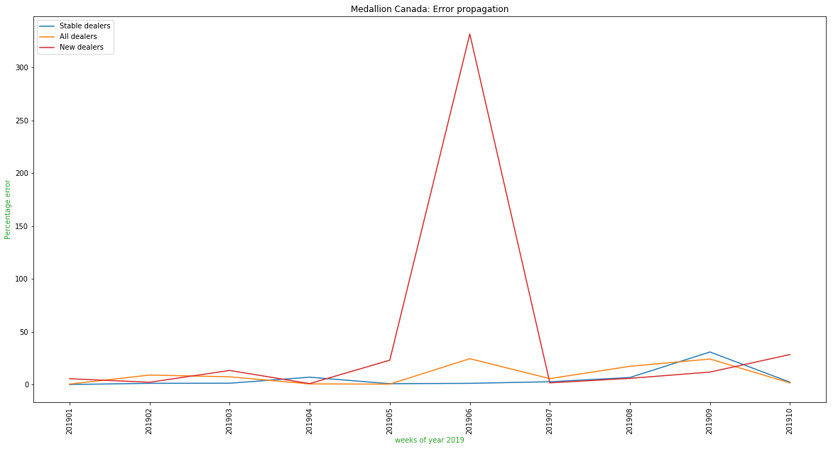
Short-term forecasting challenges
Client 1: Accurate scenario Client2: Forecast off
Spikes are not captured by the model
Contribution to these spikes comes from new dealers
Established dealers
Established dealers
Forecasted
True
Forecasted
True
New dealers
New dealers
Client 2 forecasting error propagation
Unit volume
New dealers
Error
Established dealers
All dealers
All dealers
All dealers
Weeks of the year
Weeks of the year
Weeks of the year

Slide 8
Multi-model approach to improve forecast accuracy
Client 1 | 2019 Q2 Forecast Sales Unit Volume |  |  |  | 2019 Q2 Forecasted % change (as compared to 2018 Q2)
 | Weekly | Monthly | Quarterly | Average | Weekly | Monthly | Quarterly | Average
 | 664,379 | 874,847 | 854,923 | 798,050 | -20.00% | 5.10% | 2.70% | -4.10%
Client 2 | 2019 Q2 Forecast Sales Unit Volume |  |  |  | 2019 Q2 Forecasted % change (as compared to 2018 Q2)
 | Weekly | Monthly | Quarterly | Average | Weekly | Monthly | Quarterly | Average
 | 508,748 | 623,593 | 621,819 | 584,720 | -8.0% | 12.0% | 12.0% | 5.50%

Slide 9
Multi-model approach to improve forecast accuracy
Client 1 | 2019 Q2 Forecast Sales Unit Volume |  |  |  | 2019 Q2 Forecasted % change (as compared to 2018 Q2)
 | Weekly | Monthly | Quarterly | Average | Weekly | Monthly | Quarterly | Average
 | 664,379 | 874,847 | 854,923 | 798,050 | -20.00% | 5.10% | 2.70% | -4.10%
Actual | 733,910 |  |  |  | 1.29%
Client 2 | 2019 Q2 Forecast Sales Unit Volume |  |  |  | 2019 Q2 Forecasted % change (as compared to 2018 Q2)
 | Weekly | Monthly | Quarterly | Average | Weekly | Monthly | Quarterly | Average
 | 508,748 | 623,593 | 621,819 | 584,720 | -8.0% | 12.0% | 12.0% | 5.50%
Actual | 572,730 |  |  |  | 7.25%

Slide 10
Multi-model approach to improve forecast accuracy
Client 1 | 2019 Q2 Forecast Sales Unit Volume |  |  |  | 2019 Q2 Forecasted % change (as compared to 2018 Q2)
 | Weekly | Monthly | Quarterly | Average | Weekly | Monthly | Quarterly | Average
 | 664,379 | 874,847 | 854,923 | 798,050 | -20.0% | 5.10% | 2.70% | -4.10%
Actual | 733,910 |  |  |  | -11.8%
Average | Q2 volume error
 | 8.7%
Client 2 | 2019 Q2 Forecast Sales Unit Volume |  |  |  | 2019 Q2 Forecasted % change (as compared to 2018 Q2)
 | Weekly | Monthly | Quarterly | Average | Weekly | Monthly | Quarterly | Average
 | 508,748 | 623,593 | 621,819 | 584,720 | -8.0% | 12.0% | 12.0% | 5.50%
Actual | 572,730 |  |  |  | 7.25%
Average | Q2 volume error
 | 2.1%

Slide 11
SARIMA model hyperparameter optimization
SARIMA model hyperparameters:
trend (p, d, q)
p: Trend autoregressive order
d: Trend difference order
q: Trend moving average order
seasonal (P, D, Q, N)
P: Seasonal autoregressive order
D: Seasonal difference order
Q: Seasonal moving average order
N: Number of time steps for seasonal period
Optimal model discovery methods:
Grid Search
Set aside last few months of sales observations (t_{i+1}, t_{i+2}, …, t_{i+L})
For next month/week t_{i+1} , forecast sales volume V_{i+1}(p, d, q, P, D, Q, N) for each hyperparameter combination from S=[0, 1, 2] ✕[0, 1, 2] ✕ [0, 1, 2] ✕[0, 1, 2] ✕[0, 1, 2] ✕[0, 1, 2] ✕[0, 1, 2,…,52] (weekly scale)
Choose (p, d, q, P, D, Q, N)_{opt} to minimize residual |V _{i+L} – V _{true i+L}|
Use optimal hyperparameter set to forecast future time steps
AIC (Akaike Information Criterion)-based model selection
Generate all different combinations of (p, d, q) and (P, D, Q, N)
Calculate $AIC=n×ln\frac{\sum{e_{i}^{2}}}{n}$ + 2$×k,$ $k=7$
Choose (p, d, q, P, D, Q, N)_{opt} that minimizes AIC
Notes:
Together these three parameters account for seasonality, trend, and noise in datasets:
p is the auto-regressive part of the model. It allows us to incorporate the effect of past values into our model. Intuitively, this would be similar to stating that it is likely to be warm tomorrow if it has been warm the past 3 days.
d is the integrated part of the model. This includes terms in the model that incorporate the amount of differencing (i.e. the number of past time points to subtract from the current value) to apply to the time series. Intuitively, this would be similar to stating that it is likely to be same temperature tomorrow if the difference in temperature in the last three days has been very small.
q is the moving average part of the model. This allows us to set the error of our model as a linear combination of the error values observed at previous time points in the past.
AIC provides a means for model selection, measure the quality of the model as compared to the quality of other models

Slide 12
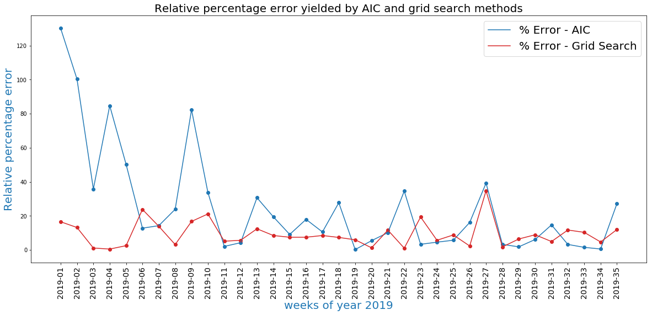
Optimized SARIMA model accuracy
MAPE | AIC | Grid Search
 | 24.8% | 9.3%
Model accuracy =100% -MAPE=90.7%
MAPE – mean absolute percentage error

Slide 13
Lessons from SARIMA forecasting
Methodology is the “master” of accuracy of prediction and technology is its “slave”
If seasonality and trend are inherent to the data, choose SARIMA model due to its capability to capture long-term trends and seasonal effects
Experiment with model building and leverage multiple models to achieve higher precision
Grid-search SARIMA hyperparameter space and discover which configuration works best
Long-term forecasting is limited in accuracy
Irrespective of temporal scale, SARIMA models cannot see too far into the future
Notes:
One of the most common methods used in time series forecasting is known as the ARIMA model, which stands for Autoregressive Integrated Moving Average. ARIMA is a model that can be fitted to time series data in order to better understand or predict future points in the series.

Slide 14
Estimation of sales lift due to promotional programs
Sales promotion programs are aimed at
gaining market share from competitors,
grow sales of certain brands.
Can we build predictive analytics tool that will help find the right levers to pull?
Will future promotional program schedule achieve an increase in sales of targeted products?
Program name
Program B
Program D
Program A
Program C
Program E
Program F
Duration
Brand
Historic records
SKUs
Payout

Slide 15
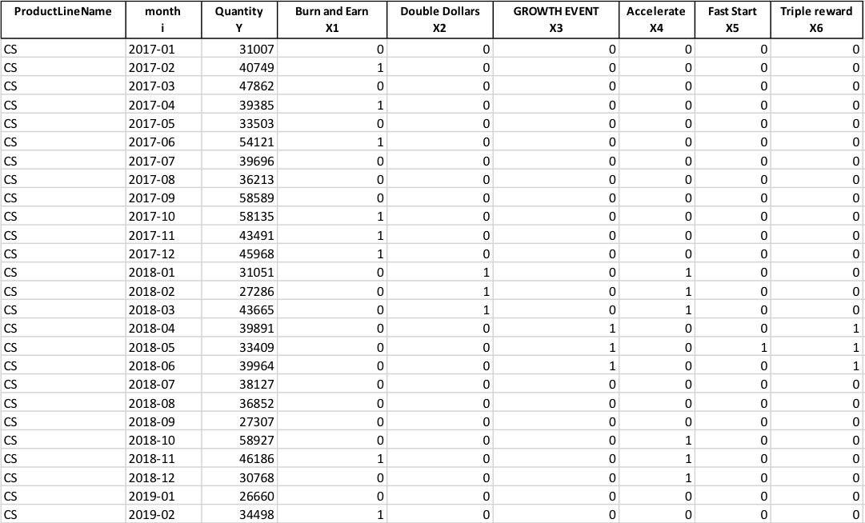
SARIMAX model – what is under the hood?
$$Y_{i}=\sum_{j=1}^{K}{β_{j }X_{ij}+ \sum_{j=1}^{p}{φ_{j} Y_{i−j}+ε_{i}+\sum_{j=1}^{q}{θ_{j}ε_{i−j}}}}$$
Exogenous variables
SARIMA model
Pythonic model setup
dat
model = sm.tsa.statespace.SARIMAX(dat, order=order, exog=exog, seasonal_order=seasonal_order, enforce_stationarity=True)
model_f=model.fit(maxiter=500)
predictions=model_f.forecast(steps=1,exog=exog_forecast)
Time series training dataset
How do we define exog_forecast array?
exog

Slide 16
Experimentation with SARIMAX model
Baseline forecast
$${exog_forecast}_{i+1}=\left[\begin{matrix}1 \\ 0 \\ 0\end{matrix}\right]$$
Promotional programs incorporated into SARIMAX model as Boolean variables influence forecasted sales volume values
Expected sales lift is only observed if there is correlation relationship between promotional activities and increase in sales
$$Sales Lift=$$
$$100\%×\frac{{Forecasted Vol}_{with promo}−{Forecasted Vol}_{baseline}}{{Forecasted Vol}_{baseline}}$$

Slide 17
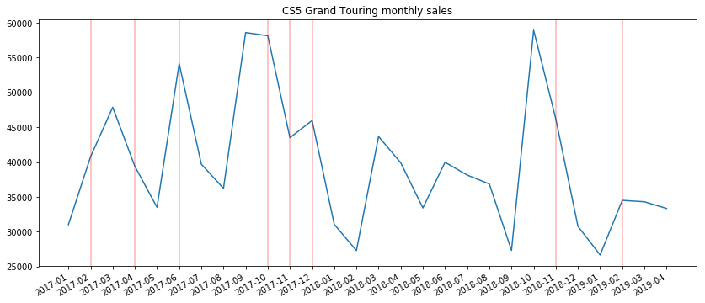
Does SARIMAX model always work?
Product 1 monthly sales
Program activation $≠$ Sales growth
“Burn and Earn” program activity periods -
Notes:
Key observation: No consistency in sales growth during program activation

Slide 18
Lessons from SARIMAX forecasting
Inclusion of exogenous variables (representing promotional programs) allows to gain insights into future impact of promotional program and product choices on sales performance
If there is no correlation between selected product sales increase and marketing activities, then the model is unlikely to forecast positive sales lift
A powerful sales lift estimation tool can be created that would
(1) enable understanding of historic relationships between sales and promotional events and future
effect on sales of targeted products
(2) and lead to smart planning of the promotional program schedule

Slide 19
Purchasing behavior analysis and prediction of reward winners
4 levels of dealer incentives
Trip to Mexico reward conditions (based on projected annual purchase quantities):
Silver
240 annual units (120 qualifying)
New and silver/gold dealers
Purchase 1,600 units (800 qualifying)
Existing dealers
Achieve your levels
Meet or exceed last year’s total units
Platinum: Grow in 2019 by 250 qualifying units vs 2018
Diamond: Grow in 2019 by 250 qualifying units vs 2018
Gold
700 annual units (350 qualifying)
Platinum
1600 annual units (800 qualifying)
Diamond
2400 annual units (1200 qualifying)
Business problem:
Estimate number of dealers who are likely to win the trip for accommodation arrangement
Make other dealers aware how far away they are from winning the trip
Solution: Forecast annual purchase unit volumes for all dealers and potential candidates to winners

Slide 20
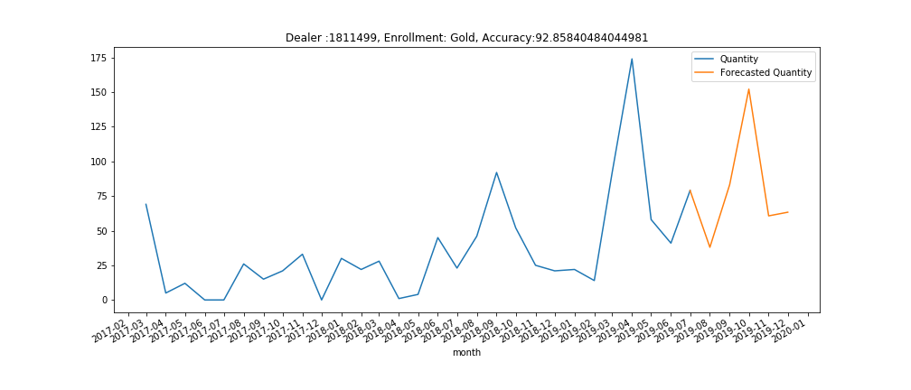
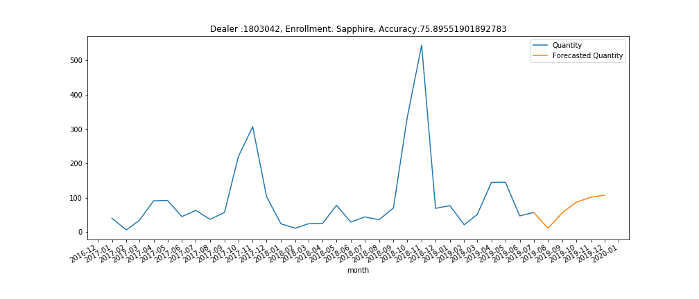
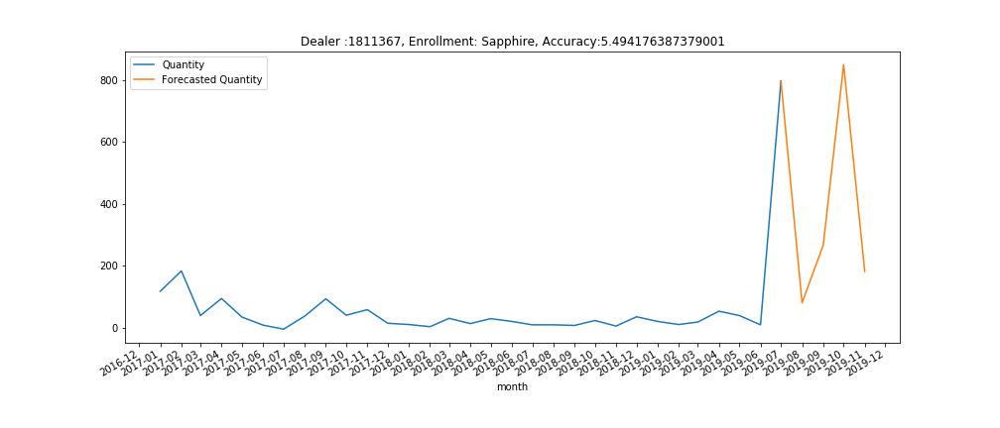
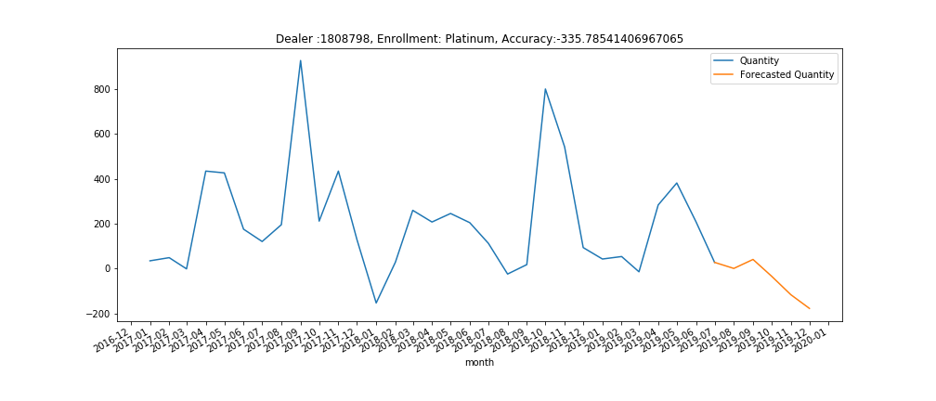
Learning dealer purchasing patterns from historic data
Recurring pattern with increasing trend
Recurring pattern with varying spike height
Purchased unit quantity
month
month
Random pattern
Steady pattern with isolated spike
Purchased unit quantity
month
month

Slide 21
Accuracy estimation and interpretation
Roll 4 months back in time${ t}_{k−1}$,${ t}_{k−2}$, $t_{k−3}$, $t_{k−4}$
Lower accuracy $⟹$ wider variability range of forecasted volume
MAPE $≈$ average % error per time step
Estimation result has to reflect uncertainty
To incorporate uncertainty into forecast we deduce lower and upper forecasted amounts from MAPE
Fit SARIMA model to all data points up to time ${ t}_{i}$ and forecast volumes
${Forecasted_Vol}_{t_{k−i}}$ ,$i=1,..,4$
MAPE$≈100\%×\frac{|{True_Vol}_{t}−{Forecasted_Vol}_{t}|}{{True_Vol}_{t}}$
Compute MAPE
$100.0\%×$ $\frac{1}{4}\sum_{i=1}^{i=4}{\frac{{|Vol}_{t_{k−i}}−{Forecasted_Vol}_{t_{k−i}|}}{{Vol}_{t_{k−i}}}}$
$$Lower estimate \left({True_Vol}_{t}\right)=\frac{{Forecasted_Vol}_{t}}{(1+{MAPE}/{100})}$$
$$Upper estimate \left({True_Vol}_{t}\right)=\frac{{Forecasted_Vol}_{t}}{(1−{MAPE}/{100})}$$
Compute accuracy
$$Acc=100.0\% −MAPE$$
Notes:
the confidence % in the report means the degree of certainty in predicted values. In order to compute it, we learn forecasting models for qualifying and total unit volumes per dealer. These models yield forecasted values with less than 100% accuracy (since 100% accurate predictive models do not exist). 64.26% tells you that there is quite a wide variability range for this dealer’s qualifying and total unit volumes (on average). This is why I report on lower and upper forecasted amounts for total volumes as well as on minimal and maximal qualifying volume differences. This is the nature of forecasting, you have to factor in uncertainty into your quantities of interest. There is absolutely nothing wrong with 64.26%, this is how accurate the forecasting model of this dealer is. In regards to the vast majority of dealers who are not winners yet, this measure tells us how confident we are that a dealer makes it to the trip (since we further work with predicted volumes to see whether they meet conditions of this reward or not).

Slide 22
Decision making on trip winners
Per dealer, compute
1. Accuracy,
2. Rest of year forecasted unit volume,
3. Lower and upper bounds,
4. 2018 qualifying unit volume
Use forecasted range to decide on dealers who are likely to meet conditions of trip reward
Build forecasting models of qualifying unit volumes per dealer
$$Lower estimate≤Target volume≤Upper estimate$$
Yes
New and silver/gold dealers
Purchase 1,600 units (800 qualifying)
Existing dealers
Achieve your levels
Meet or exceed last year’s total units
Platinum: Grow in 2019 by 250 qualifying units vs 2018
Diamond: Grow in 2019 by 250 qualifying units vs 2018
Check if 2018 volume falls within forecasted range
Platinum/diamond
Check if target difference (250 or 100 units) is within (upper bound-2018 volume) and (lower bound -2018 volume)
Existing dealers
Gold/ Sapphire
Check if 1600 units fall within forecasted range
No
Yes
No
Yes
Likely to win with % Acc
Unlikely to win
Exceptional case: The predictive model returns NaN value which means that the algorithm failed to converge. Such dealers are classified to uncertainty group.
Notes:
Per dealer, we have
learned purchasing trends from historic data via SARIMA model fitting,
propagated them into the future (until the end of 2019),
estimated model accuracy (% Acc),
estimated upper and lower forecasted quantities (forecasted range).
decision making based on forecasted individual dealer purchasing patterns (of course, some of them do not have any regularity at all, but if they cannot maintain their enrollment level that requires more or less regular purchases, then they are unlikely to be candidates for this reward)

Slide 23
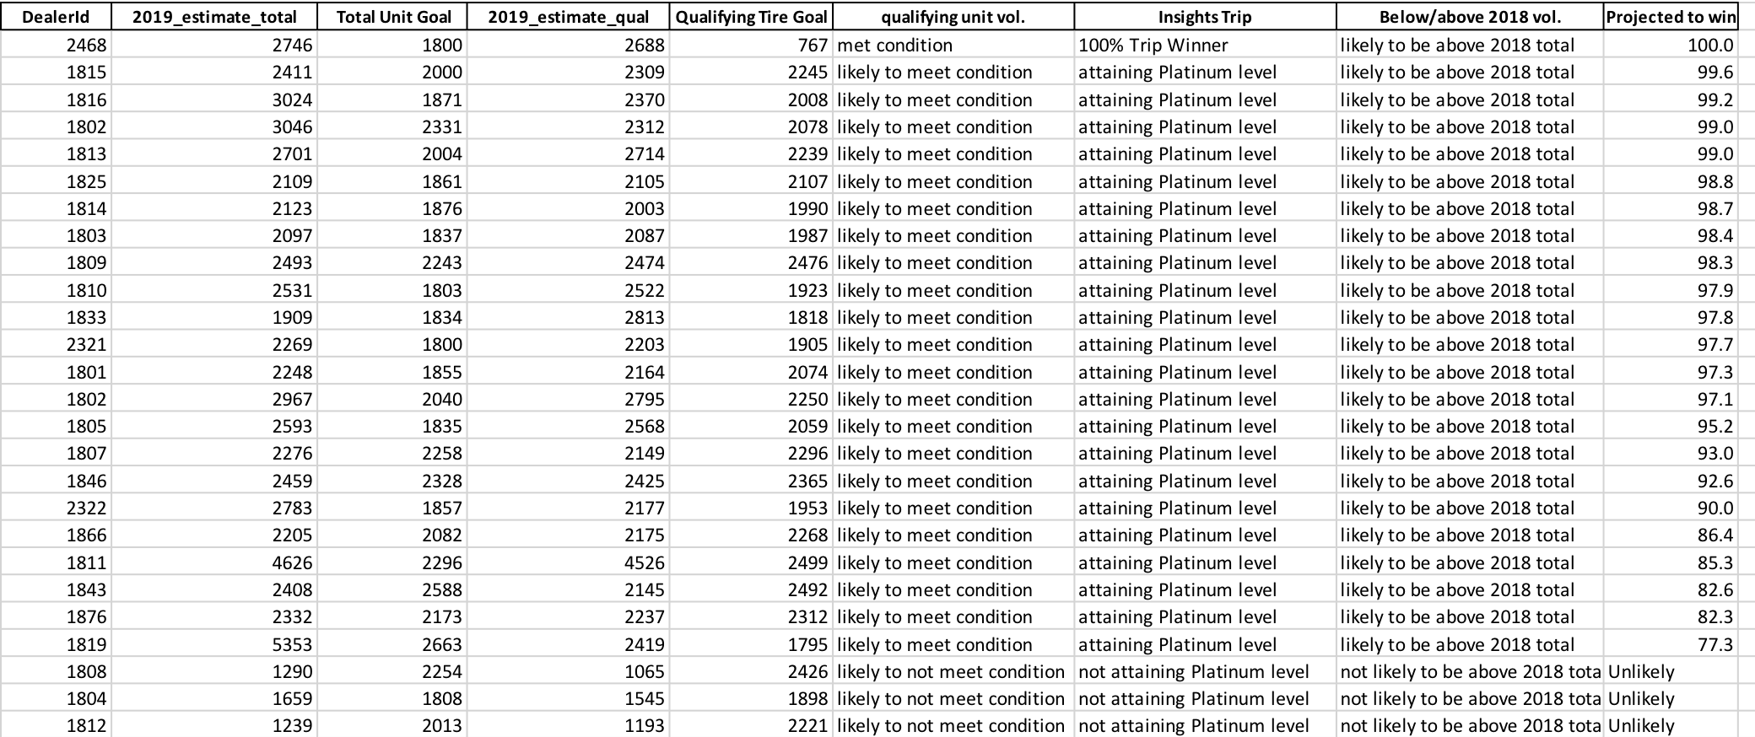
Ranking of dealers by certainty degree
Outside of forecasted range
Projected to win with 77.3% accuracy

Slide 24
Lessons from purchasing behavior forecasting
Repeated patterns in purchasing behavior are essential to reliable forecasting
Presence of sporadic spikes or dips hampers forecasting accuracy
Future uncertainty is inherent to forecasting and important to assess for informed decision making
The uncertainty is integrated into forecasted range of real values
90% (95%) prediction intervals derived from SARIMA models are too wide that renders them impractical
Model accuracy estimated using MAPE gives idea of uncertainty extent
Lower and upper purchased amounts calculated from MAPE provide desired forecasted range
MAPE-based range forecast allows to check if dealer is likely to hit targeted purchase quantity
Dealers projected to win are ranked according to model accuracy
Notes:
The assumption of SARIMA time series model is that trends and recurring patterns learned from purchase history will propagate into the future. The wider the range, the higher the uncertainty.

Slide 25
Thank you for your attention!

